Slide 1



AI Study Assistant
CIS 641 · MIDTERM STATUS UPDATE
One place for a student’s courses, deadlines and study plan, with AI advice on what to study next
Ali Belhrak · Team AIStudyAssistant · October 28, 2026
Notes:
Hi everyone, I’m Ali Belhrak. My project is the AI Study Assistant. This is a quick status update: who I am, what the project is, and the diagrams I have made so far.

Slide 2

Team AIStudyAssistant
TEAM MEMBER
ROLES
Ali Belhrak
Project manager
Systems analyst
Designer
Developer
M.S. Applied Computer Science, Grand Valley State University
Solo project: I present every part today
github.com/alibelhrak/GVSU-CIS641-AIStudyAssistant
2
Notes:
I’m working on this project by myself, so I cover all the roles: I manage the project, do the analysis and design, and build it. Everything is in my team repository, GVSU-CIS641-AIStudyAssistant.

Slide 3




The problem: school work is spread across many tools
Due dates
Study time
Materials
Hours studied
in the learning management system
in a calendar or a paper planner
in a notes app or cloud folder
usually not tracked at all
A student can see that an exam is coming, but not that they have barely studied for it, until a day or two before.
3
Notes:
Students keep their work in many different places. Due dates are in Blackboard, study time is in a calendar, notes are in a folder, and nobody really tracks how many hours they studied for each course. Because these tools don’t talk to each other, you can see an exam is coming but not that you’re behind on it. Most students only notice a day or two before.

Slide 4







The AI Study Assistant puts it all in one web app
Courses
Tasks
Deadlines
Schedule
with a weekly study goal
assignments, exams, quizzes
priorities and reminders
weekly study sessions
Materials
Progress
AI recommendations
files and links per course
hours studied vs. goal
what to study next, with a plan the student can accept or dismiss
4
Notes:
My system puts everything in one place. Students add their courses with a weekly study goal, add assignments and exams with due dates and priorities, plan study sessions, upload materials, and track hours studied. The main feature is the AI recommendation: it tells the student which course to focus on and gives a plan of study sessions they can accept or dismiss.

Slide 5

How the AI recommendation works
STEP 1 · RULES
STEP 2 · RULES
STEP 3 · LLM
STEP 4 · STUDENT
Find the study gap
Rank and plan
Explain it
Accept or dismiss
top 3 by deadline, priority and task type; sessions of up to 2 hours
writes the message and reason; rule-based text if it fails
gap = hours needed − hours studied − hours planned
accepting adds the sessions to the schedule
Key design choice: the LLM never sets the hours or dates, so it can’t invent numbers in the student’s schedule.
5
Notes:
Click to reveal each step. The recommender is a hybrid. First, rules calculate the study gap for each upcoming task: the hours it needs minus the hours already studied and planned. Then the rules rank the gaps and build a plan. Only then does a language model write a short message and reason. The model never changes the numbers. If the model is down, the system uses rule-based text instead. Finally the student accepts or dismisses the plan.

Slide 6
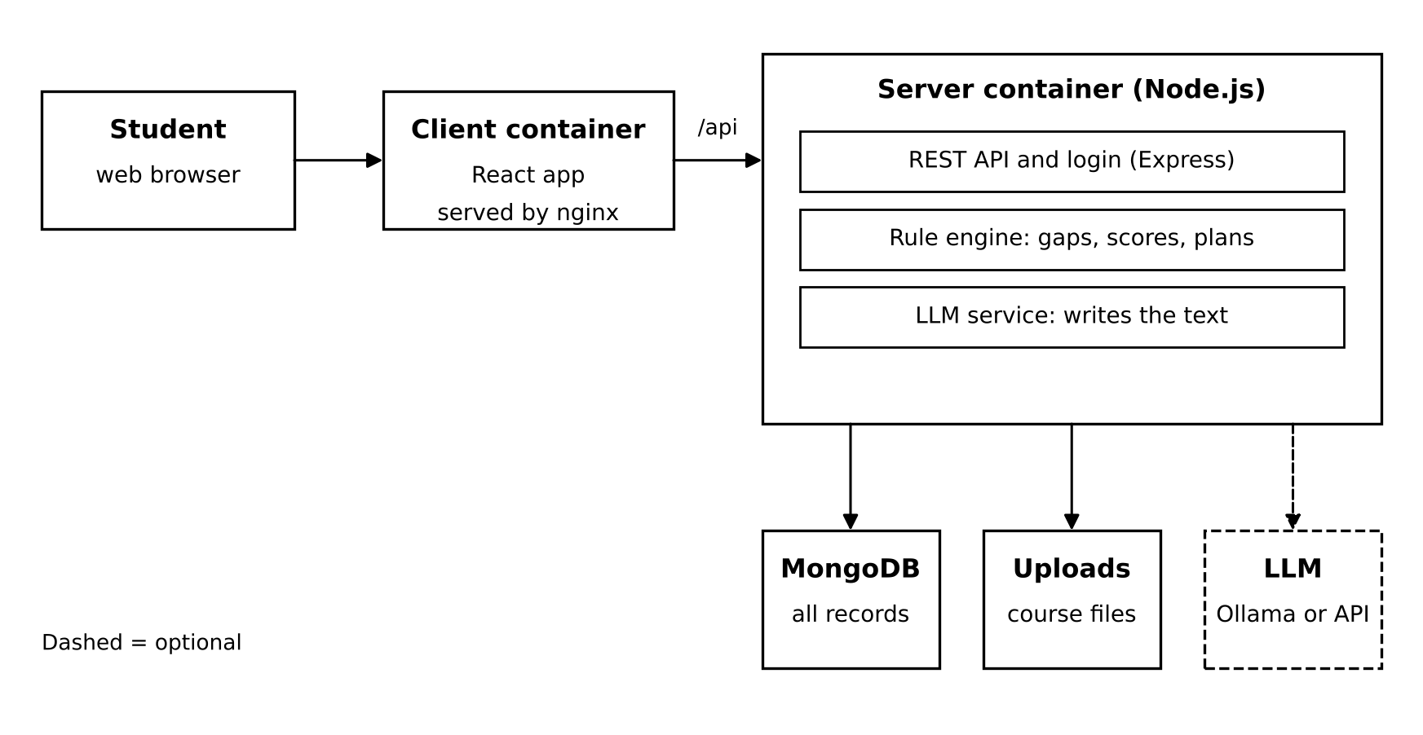
Architecture: a MERN web app in Docker
React front end
Express + Node.js API
MongoDB database
Llama 3.2 via Ollama (optional)
Docker Compose starts it all
6
Notes:
This is the architecture. The student uses the React app in the browser. It talks to the Express server only through /api. The server has three parts: the REST API with login, the rule engine, and the LLM service. It stores data in MongoDB and files in an uploads folder. The LLM is optional; I use Llama 3.2 locally with Ollama, so it costs nothing. Docker Compose starts everything with one command.

Slide 7
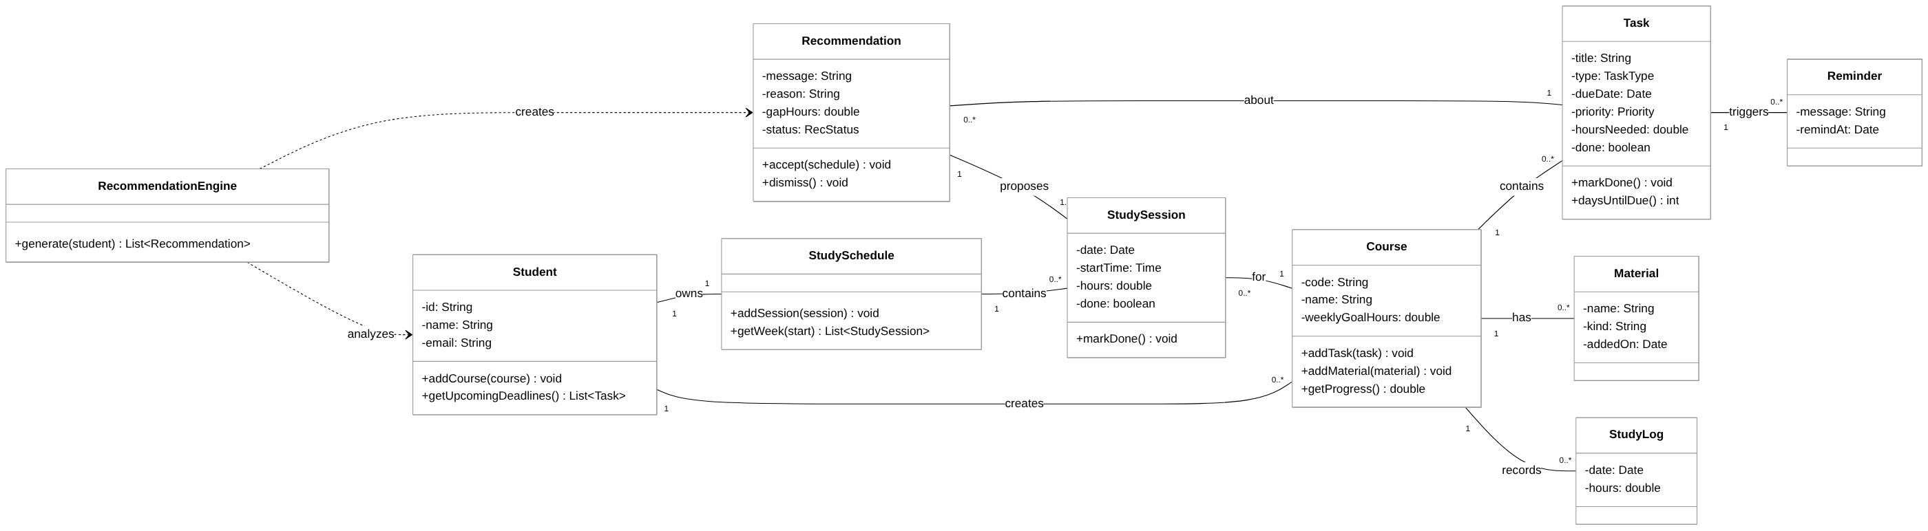
UML class diagram
A Student creates Courses, which hold Tasks, Materials and Study Logs. The RecommendationEngine reads the student’s data and creates Recommendations that propose Study Sessions.
7
Notes:
Here is the class diagram. A Student creates Courses, and each Course contains Tasks, Materials and Study Logs. The Student has one Study Schedule made of Study Sessions. On the left, the RecommendationEngine analyzes the student and creates Recommendations. Each Recommendation is about one Task and proposes one or more Study Sessions. Tasks also trigger Reminders.

Slide 8
CRC cards for the main classes
RecommendationEngine
Course
Recommendation
RESPONSIBILITIES
RESPONSIBILITIES
RESPONSIBILITIES
Find tasks due in 14 days
Calculate each study gap
Rank the gaps
Build a session plan
Create recommendations
Know its code, name and goal
Keep its tasks
Keep its files and links
Record study time
Report weekly progress
Know its message and reason
Know which task it is about
Hold the proposed sessions
Add sessions when accepted
Hide itself when dismissed
COLLABORATORS
COLLABORATORS
COLLABORATORS
Student, Task, Course, StudySchedule, StudySession, Recommendation
Task, Material, StudyLog, StudySession
Task, StudySession, StudySchedule
8
Notes:
These are CRC cards for the three most important classes. The RecommendationEngine finds upcoming tasks, calculates the study gap, ranks them and builds a plan. The Course keeps its tasks, files and study time and reports progress against the weekly goal. A Recommendation knows its message and the task it is about, and adds its sessions to the schedule when the student accepts it.

Slide 9
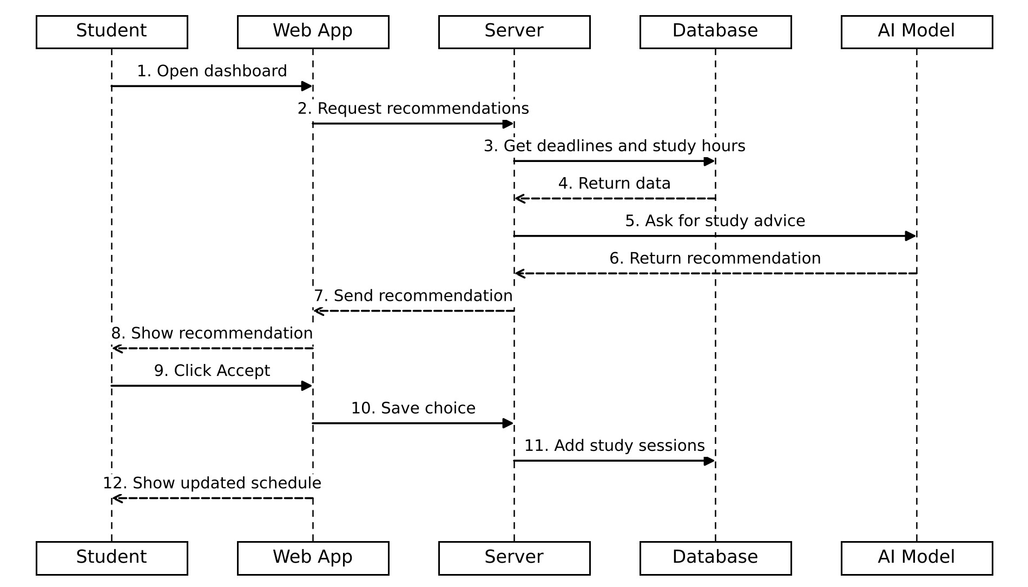
Sequence diagram: getting and accepting a recommendation
Steps 1–4: the server gets deadlines and study hours
Steps 5–8: the AI model writes the advice
Steps 9–12: the student accepts and the schedule updates
9
Notes:
Click to reveal each group of steps. This sequence diagram shows the main use case. The student opens the dashboard, and the server gets their deadlines and study hours from the database. Then it asks the AI model for the advice, and the recommendation is shown to the student. When the student clicks Accept, the server saves the new study sessions and the schedule updates. Solid arrows are messages and dashed arrows are replies.

Slide 10
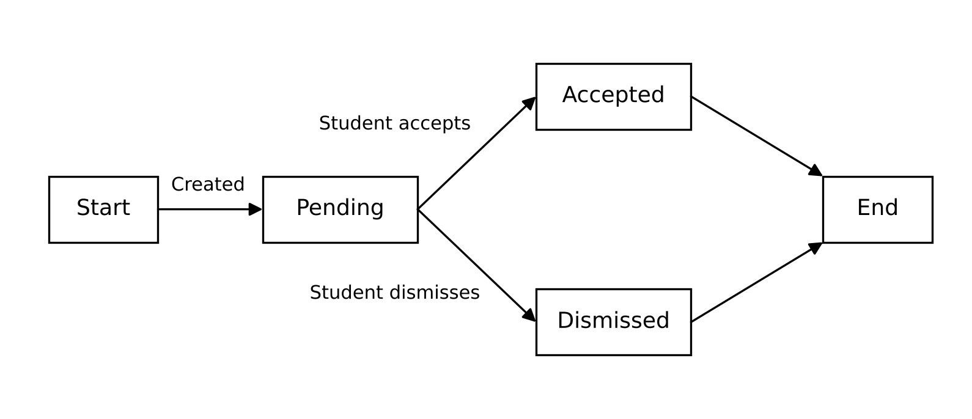
State machine diagram: a recommendation’s life
Pending: shown, waiting for the student
Accepted: sessions added to the schedule
Dismissed: hidden from the dashboard
10
Notes:
This state machine shows the life of one recommendation. It is created when the student has a deadline coming and has not studied enough. It stays Pending until the student decides. If they accept, it becomes Accepted and the sessions go into the schedule. If they dismiss it, it becomes Dismissed and is hidden.

Slide 11
Where the project stands
DONE
NEXT
Project proposal
Software requirements specification
Class diagram and CRC cards
Sequence and state machine diagrams
Early prototype of the main screens and the recommendation rules
Connect the screens to the Express and MongoDB back end
Add student accounts
Plug in Llama 3.2 through Ollama
Test every objective
Final report and demo
11
Notes:
So far I have the proposal, the requirements specification, and all the design diagrams, plus an early prototype of the main screens and the recommendation rules. Next I’ll connect the screens to the real back end, add accounts, plug in the local Llama model, and test each objective, for example that a student with an exam in three days and no study time gets that course recommended first.

Slide 12
Thank you. Questions?
Repository: github.com/alibelhrak/GVSU-CIS641-AIStudyAssistant
Portfolio: alibelhrak.github.io
Ali Belhrak · CIS 641 · Midterm Status Update
Notes:
That’s my status update. Thank you, and I’m happy to take any questions.

